Slide 1
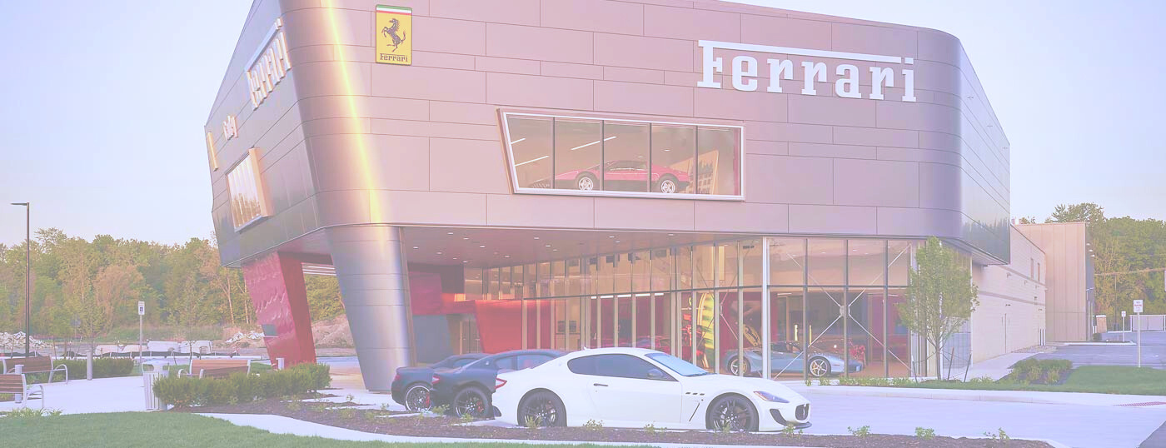
M&A Grand Prix: Where Speed Meets Strategy
The Great Wall Street of UT/Texas
Kaiwen Tai | Olivia Pan | Lingya Qiao
Lucy Liu | Zhan Su
The University of Texas at Austin
Arial

Slide 2

Table of Contents
Executive Summary
I.Market Analysis
II.Strategic Fit
III.Financial Analysis
IV.Feasibility
V.Alternative Solution
VI.Conclusion
Appendix

Slide 3
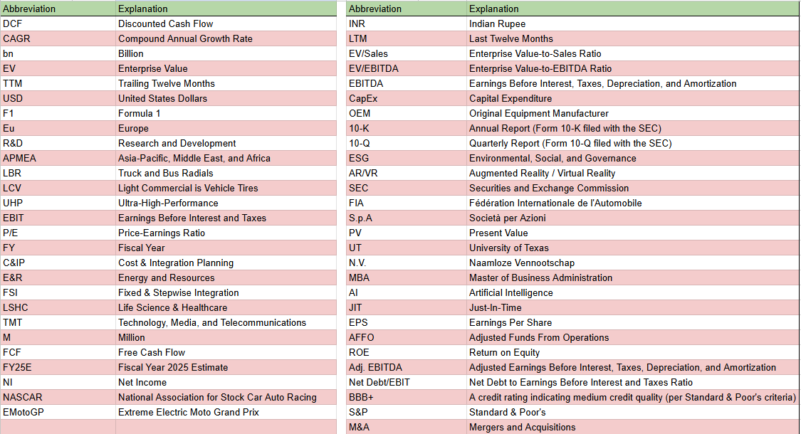
Table of Abbreviations

Slide 4
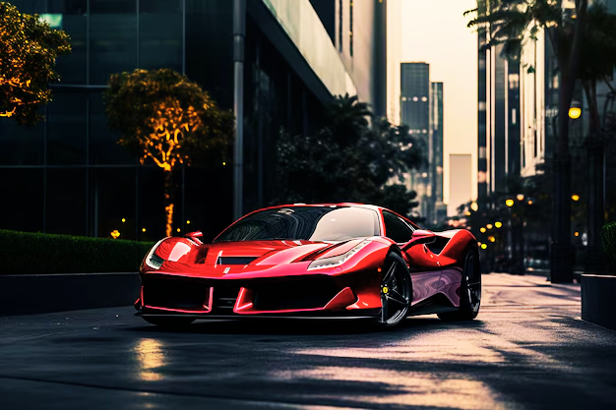
Executive Summary

Slide 5
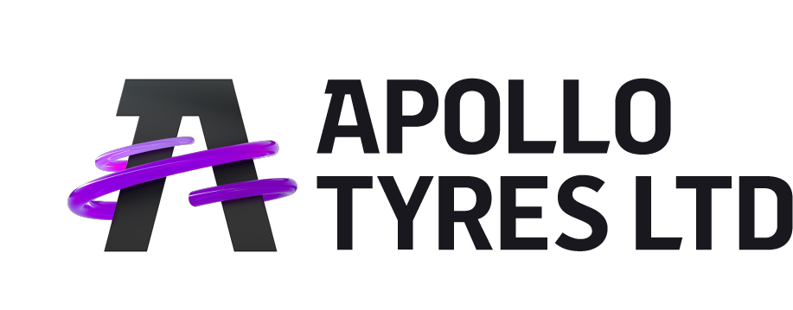
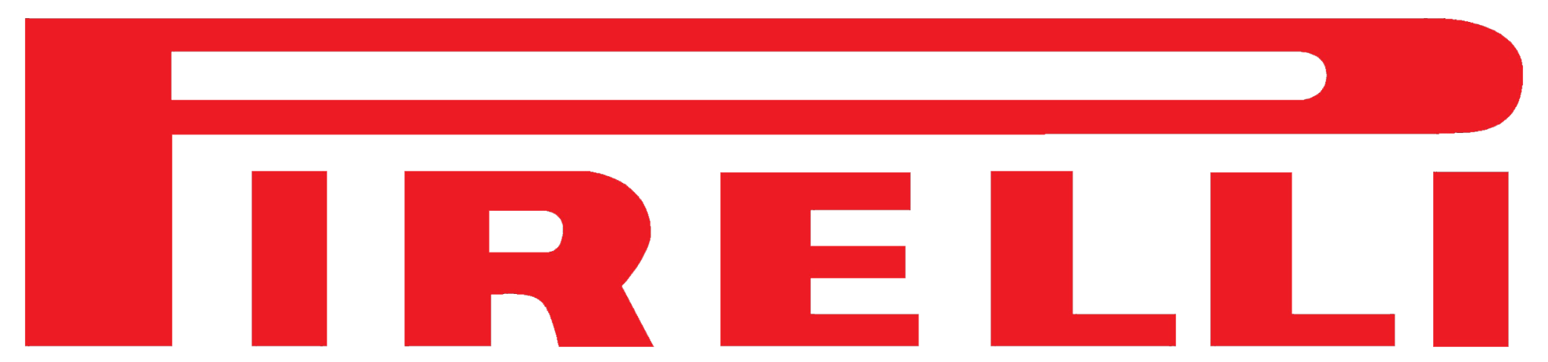





Executive Summary
Ferrari should not buy Pirelli but acquire value vault company Apollo Tyres to enhance performance, innovation and market reach
Pirelli has no synergistic technological complementarity with Ferrari, making a full acquisition operational inefficient
Through its Vredestein brand, Apollo Tyres specializes in high-performance tires, aligning with Ferrari’s luxury and performance focus
At a market valuation of $9 bn EV, Pirelli is overvalued 25% by DCF
Even with business strategy synergies, acquiring Pirelli at a premium would still destroy shareholder value
Apollo Tyres presents a financially viable acquisition target, with a lower market capitalization (~ $2.71 bn) and strong growth potential 9.7% CAGR)
Given the transaction size around $6 bn, a cash deal is not financially feasible as inordinate debt issuance is needed
The acquisition supports Ferrari’s electrification roadmap, market expansion, and supply chain efficiencies.
Given the transaction size around $3 bn, a cash deal is financially feasible
Executive Summary
Market Analysis
Strategic
Fit
Financial
Analysis
Feasibility
Alternative
Solution
Conclusion

Slide 6
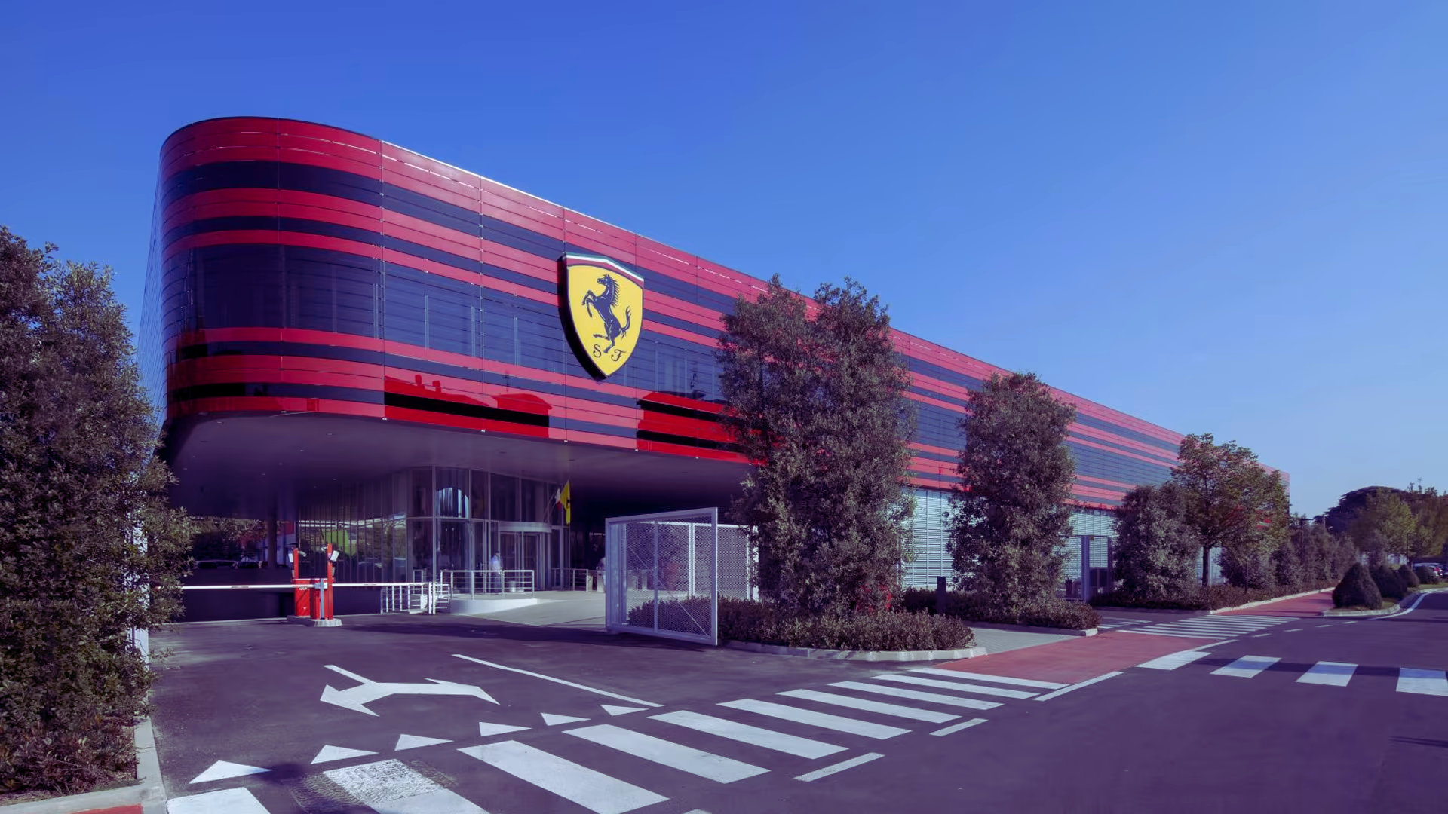
Market Analysis

Slide 7
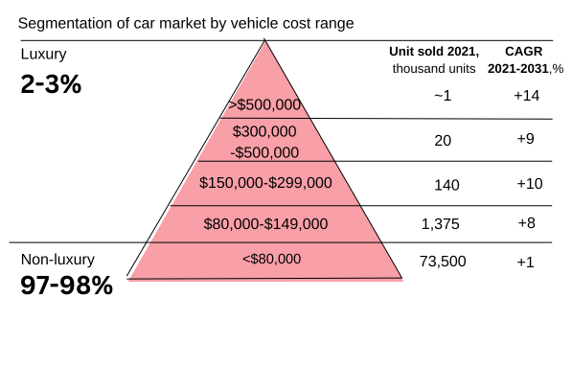

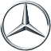
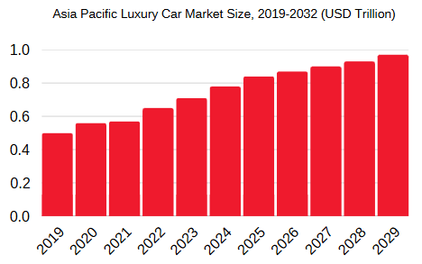
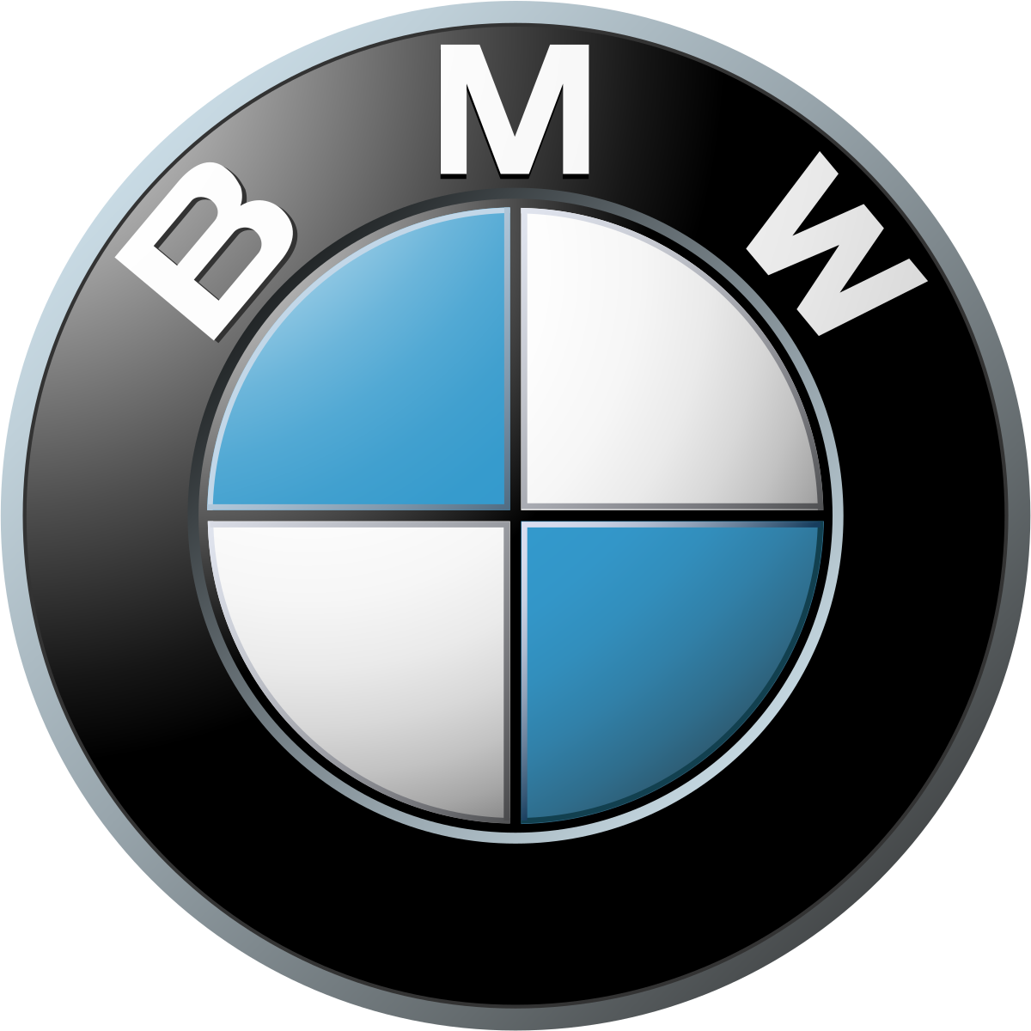
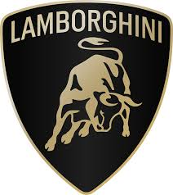
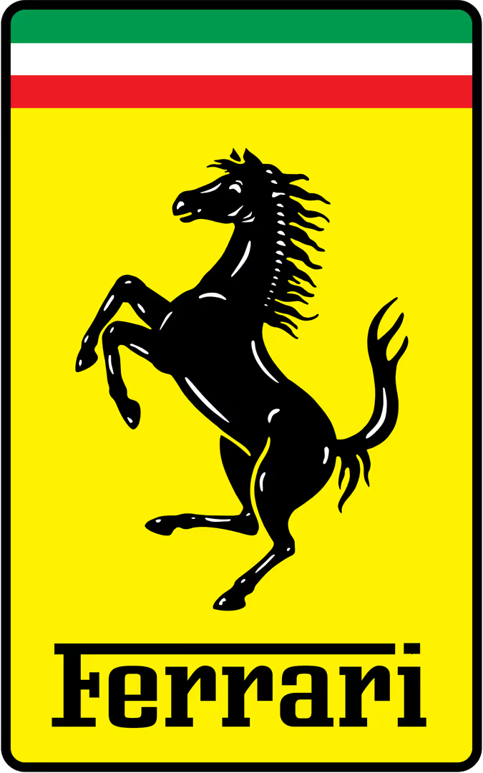
Introduction to Luxury Automotive Engineering Market
The global luxury car market size was valued at USD 1.17 trillion in 2023 and is projected to grow to USD 2.79 trillion by 2032, with CAGR of 10.1%.
There are three main factors for market growth:
Engineering Excellence
Powerful engine including V12s or hybrid
powertrains.
Better handling, speed, and driving comfort compared to mainstream cars.
Custom Design
Alcantara, a suede-like microfiber, is a popular choice for headliners, steering wheels, and seat inserts.
Many brands offer bespoke grilles, wheels, and custom design elements
Advanced Technology and Innovation
Advanced suspension system, cutting edge technology, and and AI-assisted driving. Many luxury brands lead in innovation.
Key Players in the industry:
The luxury market will grow to serve the wealthy:
Mercedes-Benz's latest financial reports the company's current revenue (TTM ) is $161,200 million USD.
BMW’s annual revenue for 2023 was $168,296 million USD, a 12.01% increase from 2022.
Lamborghini generated revenues of $2,547 million USD in 2024, an increase of 20.1% versus last year.
Ferrari annual revenue for 2023 was $6,461 million USD, a 20.36% increase from 2022.
Source: (Business Research Insight,2024), (Fortune Business Insight, 2025), (McKinsey, 2022), (market cap for Mercedes), (Buyer Guide, 2022)
Executive Summary
Market Analysis
Strategic
Fit
Financial
Analysis
Feasibility
Alternative
Solution
Conclusion

Slide 8
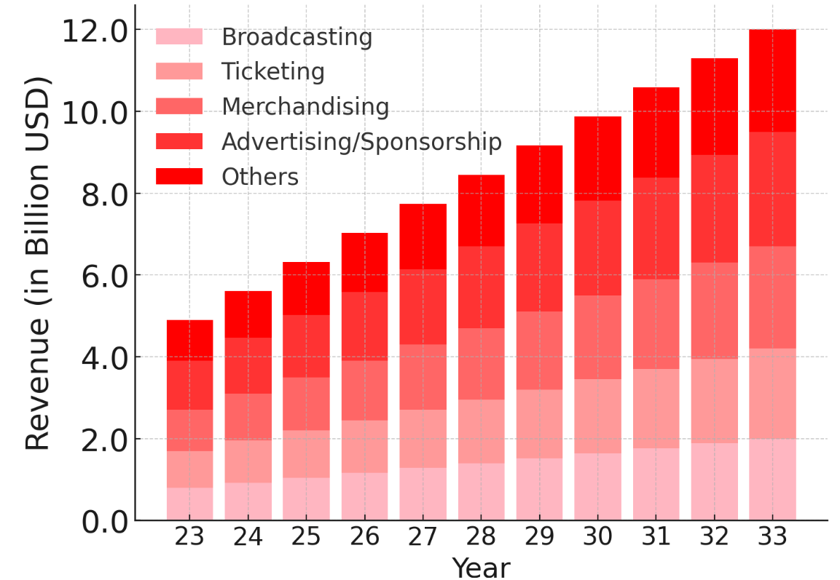
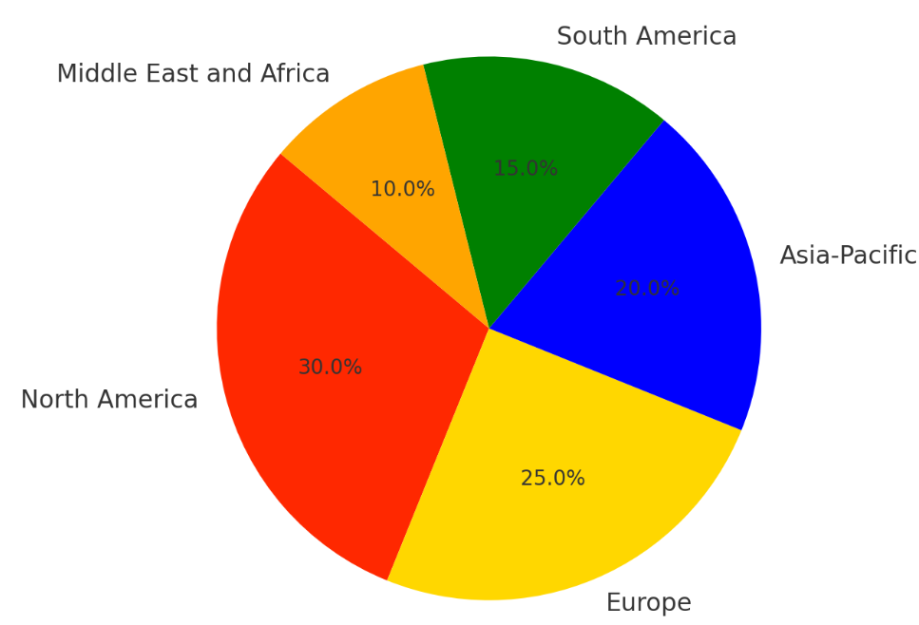



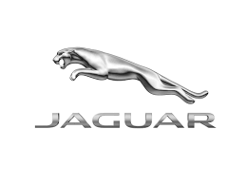
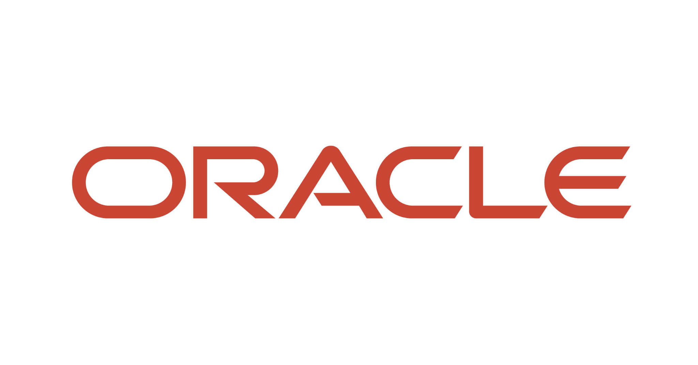
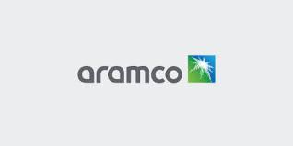
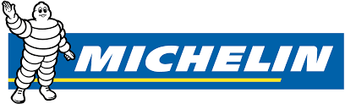
Introduction to Motorsport Market
The motorsport market was valued at USD $5,110 million in 2022, and it is projected to reach a valuation of $7,470 million USD by 2028, with CAGR of 7.9%
Motorsport Market Information:
Trends in Market:
Rise of Electric Vehicle Racing
Digital Transformation and Esports
Innovation in vehicle technology
Expansion of Global Motorsports
Increasing Diversity and Inclusivity
Technological Advancement in Broadcasting
Focus on sustainability
Key Players:
Key Sponsors in the industry:
Formula 1 Group
NASCAR
Forna Sports
FIA World Rally Championship
Extreme EMotoGP
Formula E Holdings
Red Bull Racing
Mercedes- AMG Petronas Formula One Team
Scuderia Ferrari
Racing Type:
Formula Racing
Tour Car Racing
Sports Car Racing
Off_Road Racing
Motorcycle Racing
Electric Motorsports
Source: (Motorsports Market, 2025), (Virtue Market Research), (Business research insights.com, 2025), (Yahoo Finance, 2025)
Executive Summary
Market Analysis
Strategic
Fit
Financial
Analysis
Feasibility
Alternative
Solution
Conclusion

Slide 9
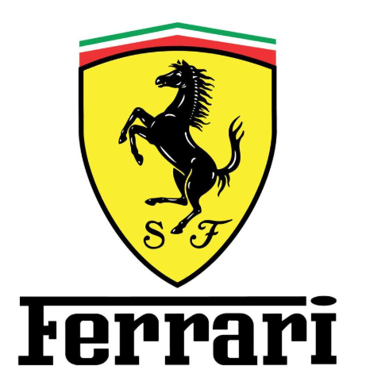
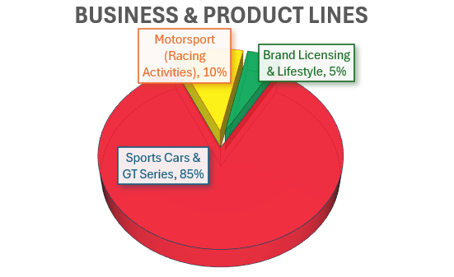
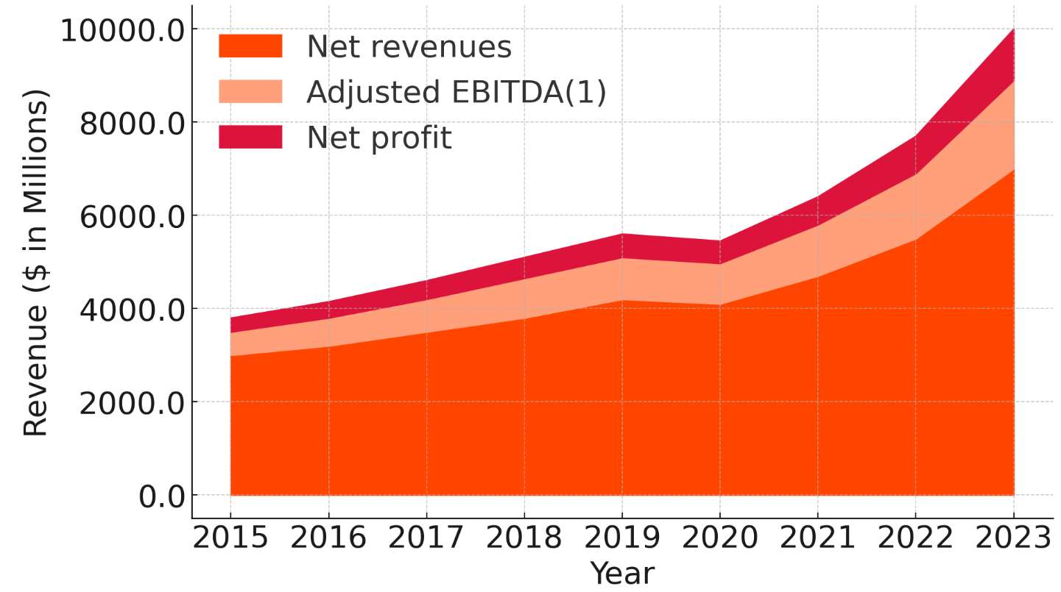
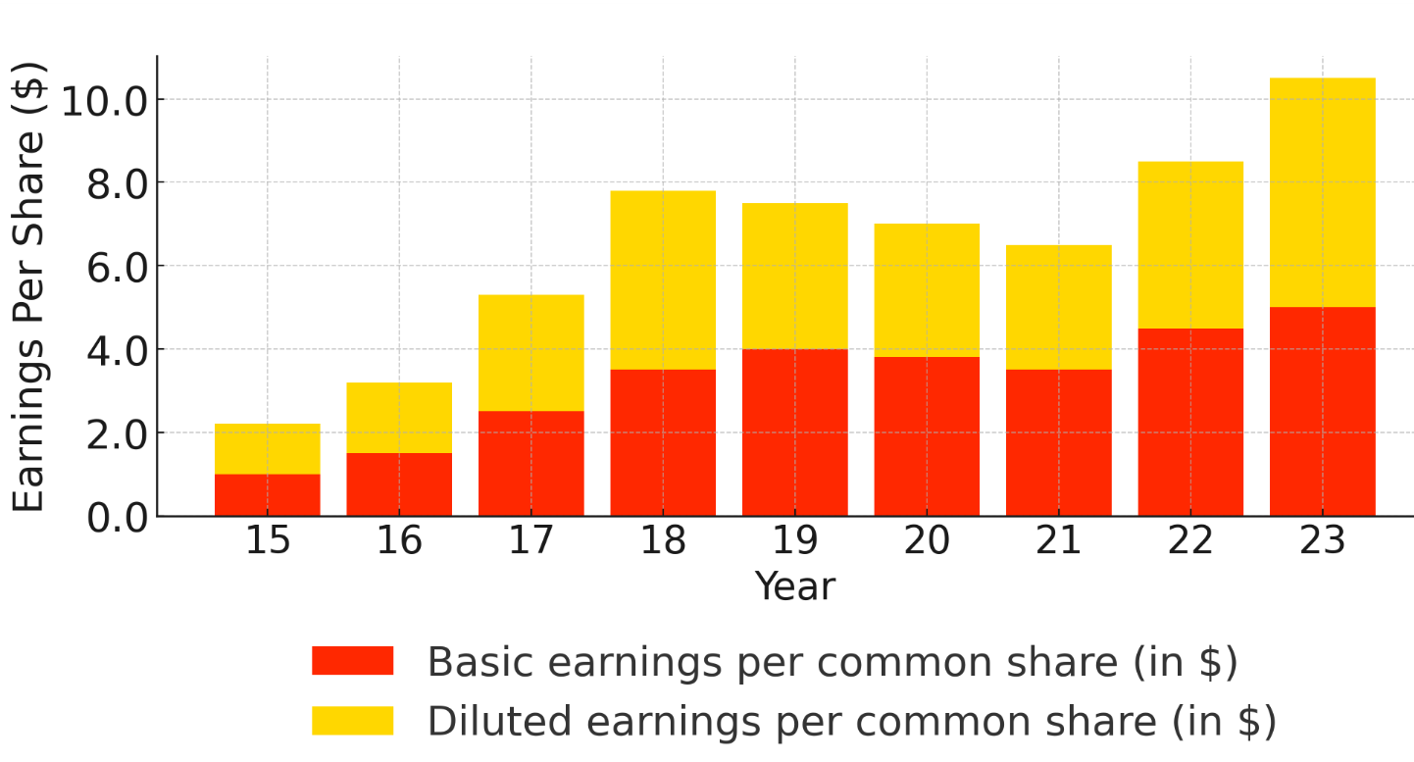
Ferrari N.V. 2025: Engineering Excellence, Electrifying Future
Core Business , Financial Highlights , Strategic Focus , Market Position
Ferrari Financials Overview:
Ferrari Revenue and Margin:
Revenue Growth (2020-2027): $3,000 million - $6,270 million USD
Gross Profit Margins: 50%
Net Profit Rate : 18-21%
Cash Flow(2023): 9,780 million USD
Debt(2023): 1,400 million USD
Stock Performance & Valuation :
Price/earnings ratio(2025): 70+
Market Capitalization(2025): 94,500 million USD
Enterprise value/EBITDA : 30-40X
Earnings Per Share Trend:
Ferrari Market Overview:
Ferrari Strategic Plan :
Sales : Eu/Mid East/Africa :45%;
Asia: 29%; Americas : 26%
Electrification Roadmap: By 2026, 60% of Ferrari vehicles be hybrid or fully electric, and will be 80% by 2030
Motorsport and R&D Innovation– Hypercar 499P
Luxury Brand Positioning-keep the brand exclusive even as the business grows
Low volume of production, High price & Customization and special editions
Growth : Ferrari continued raised 3.3% shipments per year since 2022 and 18.5% jump over 2021
Source: (MacroTrends, 2024), (Ferrari Corporate, 2024), (Carscoops, 2024),(Ferrari, 2024),(CarExpert, 2024), (BIT:RACE Financials, 2024),(Business Research Insight, 2024),(Ferrari Press Release, 2024)
Executive Summary
Market Analysis
Strategic
Fit
Financial
Analysis
Feasibility
Alternative
Solution
Conclusion
Notes:
Ferrari | Company Overview & News

Slide 10

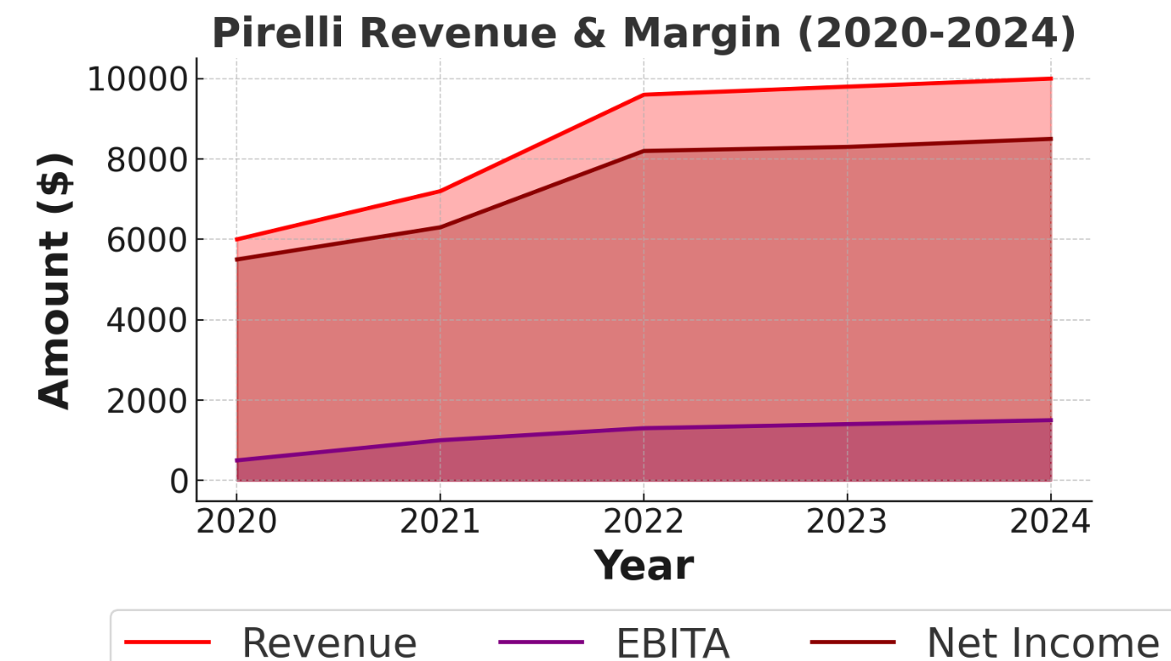
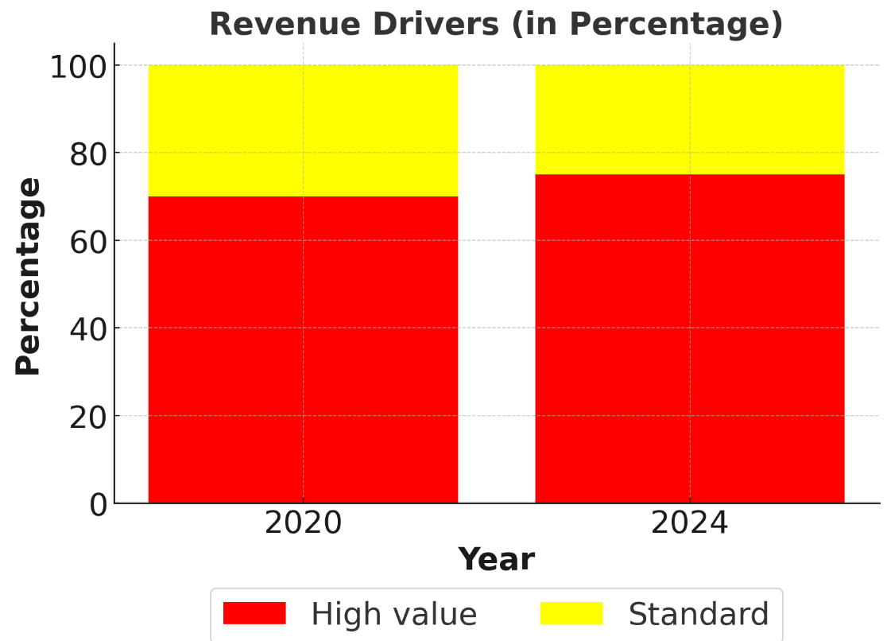
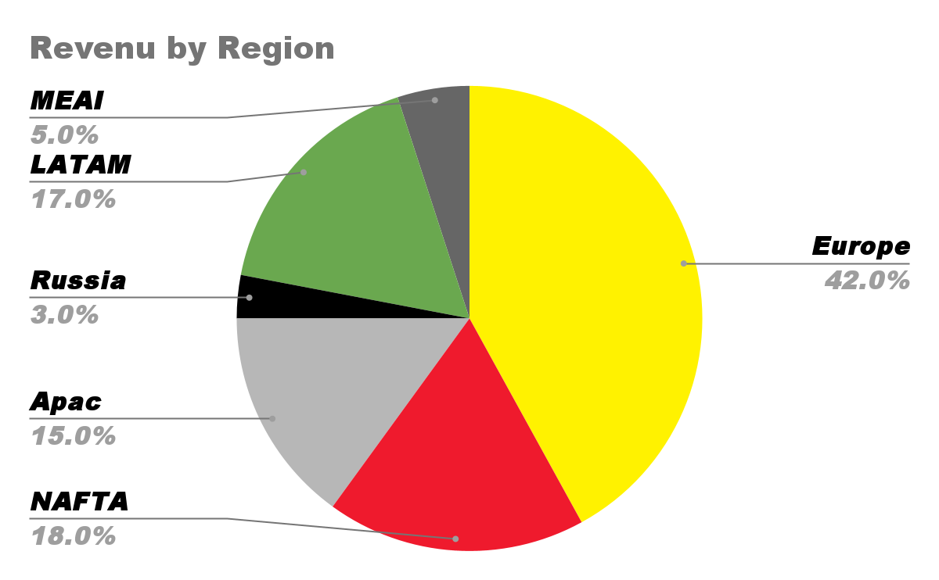
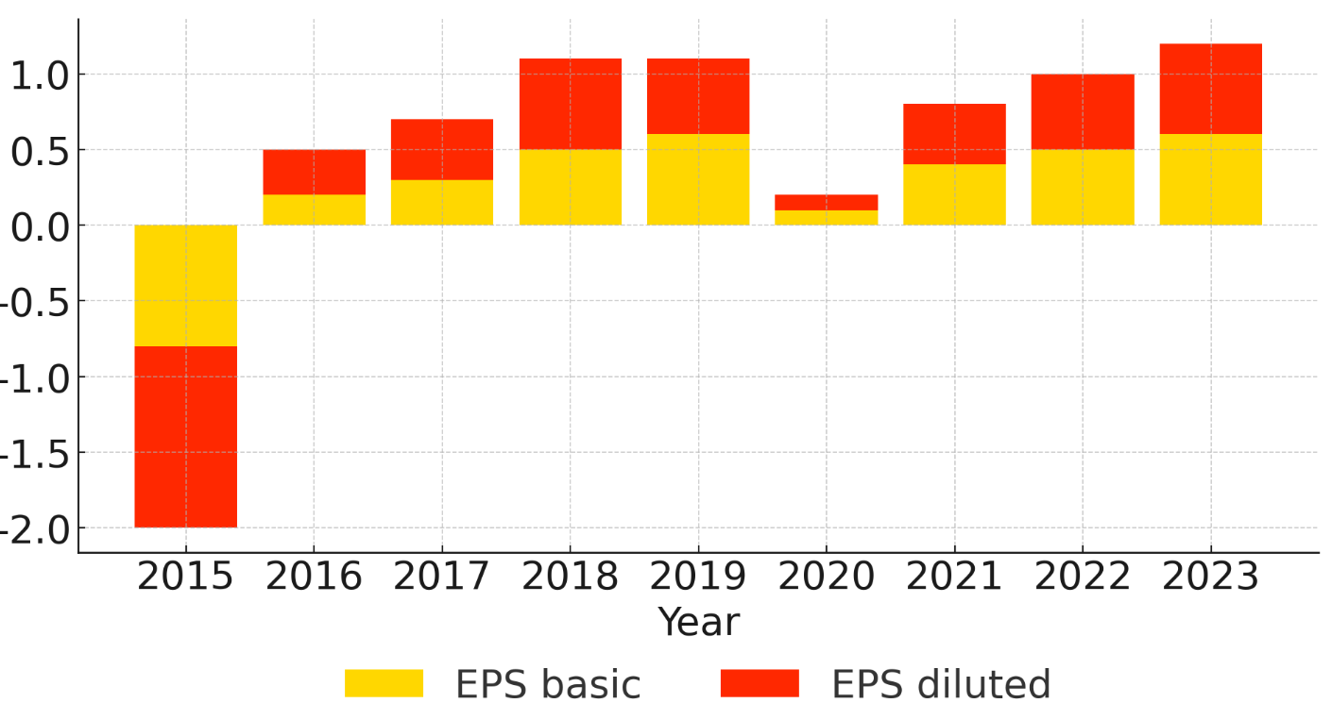
Pirelli & C. S.p.A
Core Business , Financial Highlights , Strategic Focus , Market Position
Pirelli & C Financials Overview:
Revenue Growth (2020-2027): $4.500 million - $6,000 million USD
Gross Profit Margins (2023): 33.85%
Net Profit Rate : 6-7%
Cash Flow(2023): 303.60 million USD
Debt(2023): 3392.55 million USD
Stock Performance & Valuation :
Price/earnings ratio(2025): 14+
Market Capitalization(2025): 6000 million USD
Enterprise value/EBITDA : 6.6-8.6X
Pirelli Market Overview:
Earnings Per Share Trend:
Pirelli Strategic Plan and mission
Sales : Eu/Mid East/Africa-45%; Asia - Pacific : 39%; Americas : 26%
Low volume of production, high price
Customization and special editions
Headquartered in Italy, plans of expanding the U.S market, mitigate tariff impacts
Sustainability goals of science-based Net zero approach, aim to reduce energy consumption by 80% in 2026
Focus on high value and speciality tires for premium vehicles
Sole tire provider of Formula 1
Source: (MacroTrends, 2024), (Ferrari Corporate, 2024), (Carscoops, 2024),(Ferrari, 2024),(CarExpert, 2024), (BIT:RACE Financials, 2024),(Business Research Insight, 2024),(Ferrari Press Release, 2024)
Executive Summary
Market Analysis
Strategic
Fit
Financial
Analysis
Feasibility
Alternative
Solution
Conclusion

Slide 11
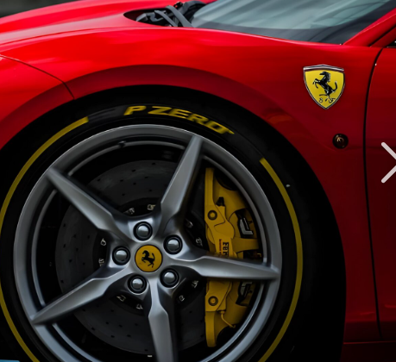
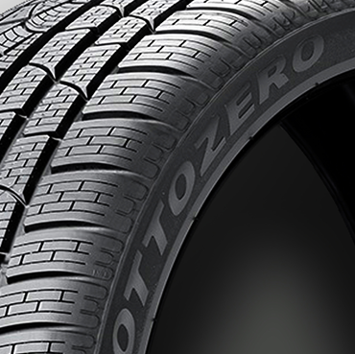
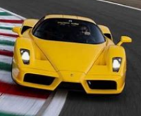
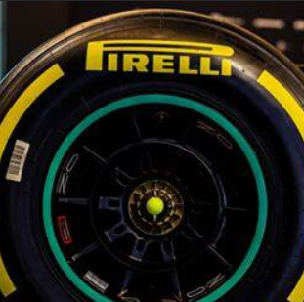
Potential Strategic Synergies
The potential for cross selling, up selling, market power capture, and end to end capability synergies exist between Ferrari and Pirelli
Cross - Selling
Integration beyond OEM fitment: Ferrari can integrate Pirelli’s tire solutions throughout its ecosystem, not just on new cars.
Pirelli access to Ferrari’s clientele: Pirelli gains a direct channel to Ferrari’s exclusive customer base, which is composed of enthusiasts who demand top-tier performance products.
Co-branded and exclusive tire lines: A deeper partnership opens the door to co-branded tires and Ferrari-specific editions from Pirelli.
Up - Selling
Premium performance bundles: Ferrari can create high-end packages that bundle Pirelli’s latest tire technology with exclusive driving experiences.
Tire personalization and track-specific sets: Both brands can tap into personalization trends, offering made-to-order tire options for Ferrari buyers.
Dealers as premium tire retailers: Ferrari’s global dealer and service network can become a high-end sales channel for Pirelli’s aftermarket business.
Market Power
Control over brand experience & pricing: By internalizing Pirelli’s tire supply (through an exclusive partnership or deeper integration), Ferrari can exert greater control over a critical aspect of vehicle performance.
Exclusive partnership as competitive moat: A deep alliance or exclusivity contract between Ferrari and Pirelli can create a formidable barrier against rival tire manufacturers.
Luxury branding and exclusivity synergies: Both Ferrari and Pirelli occupy the pinnacle of brand perception in their respective domains – Ferrari for sports cars and Pirelli for performance tires.
End-to-End
Capabilities
Joint R&D and innovation (including EV tires): A tighter strategic coupling enables Ferrari and Pirelli to collaborate from the very start of vehicle development.
Manufacturing and supply chain efficiency: Closer integration can also unlock cost and efficiency gains in production and logistics. It will just-in-time delivery of tires and reducing inventory holding costs for both.
Integrated ecosystem & smart technology: The Ferrari-Pirelli partnership can create a seamless performance ecosystem that extends from the vehicle to services to digital experiences.
Source: (Pirelli, 2024), (Ferrari Corse Clienti, 2024), (Ferrari.com, 2024), (Pirelli Press Release, 2024), (Ferrari Corporate, 2024), (Pirelli Classic Collection, 2024).
Executive Summary
Market Analysis
Strategic
Fit
Financial
Analysis
Feasibility
Alternative
Solution
Conclusion
Notes:
Ferrari | Company Overview & News

Slide 12
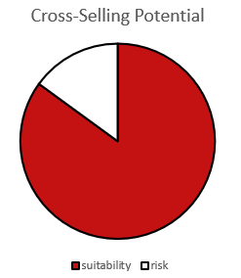
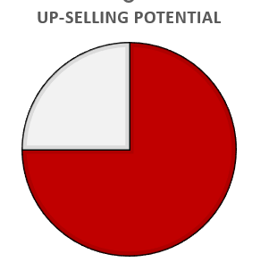
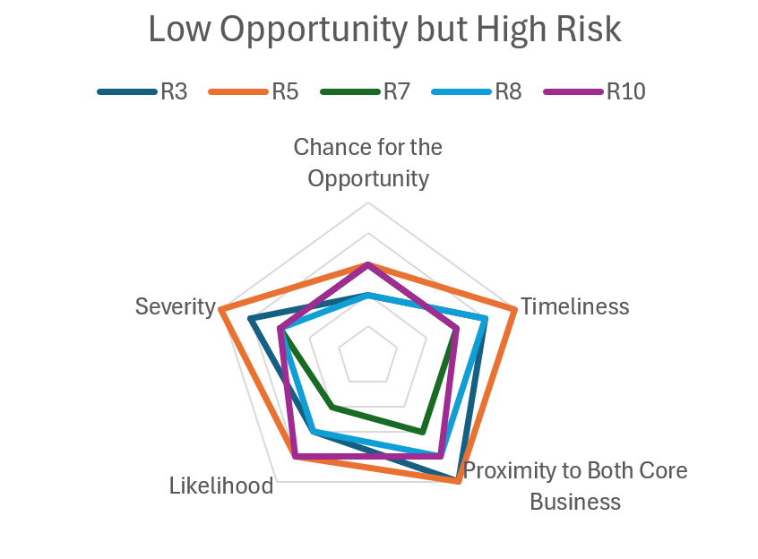
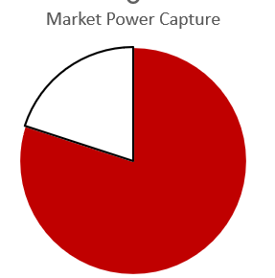
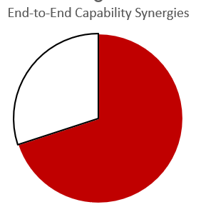
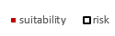
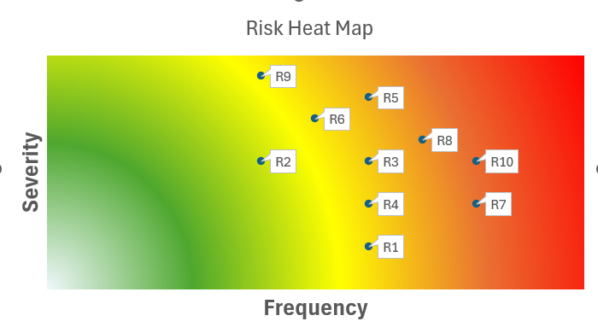

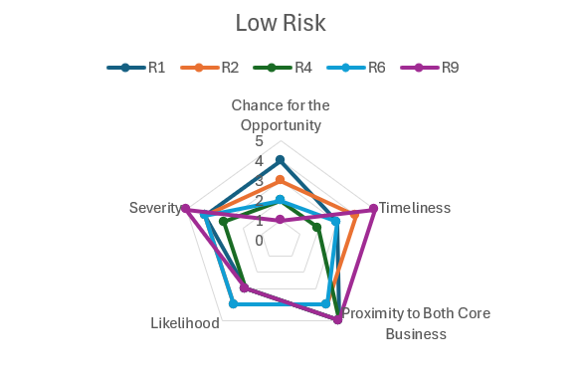

Potential Strategic Risk
Cooperation could damage the exclusive and high-end image on which Ferrari and Pirelli rely, undermining consumer trust and market dominance.
High Risk (R3, R5, R7, R8, R10):
R1 – Technology/R&D Mismatch
R2 – Brand Positioning Conflict
R3 – Pricing & Profit Distribution Disputes
R4 – Excessive Concentration of Negotiation Power
R5 – Supply Chain & Delivery Disruptions
R6 – Market Demand Volatility
R7 – Aftermarket & Competitor Tire Alternatives
R8 – Forced Product Adoption & Customer Dissatisfaction
R9 – Reputational/Image Damage
R10 – Internal Coordination Complexity
Rationale: These areas offer significant synergy and revenue potential but carry high impact if mishandled (e.g., disrupted deliveries, lost loyalty, escalated costs).
Low Risk
(R2, R9, R1, R6, R4):
These percentages assess both the maturity and implementation risks of collaboration, while also considering resource, brand, competition, and market factors. Cross-Selling and Market Power are feasible but require caution against over-reliance and pricing issues. |Up-Selling has strong potential but is sensitive to the economy and customer preferences. End-to-End Capability is strategically valuable but has higher complexity, costs, and integration challenges, making its score slightly lower
Rationale: They pose fewer immediate upsides and are relatively easier to control through proactive brand management, planned roadmaps, and vigilant market analysis.
Source: (Pirelli R&D Today, 2024), (Ferrari Press Release, 2022), (MBA Skool, 2024), (Pirelli Financial Report, 2023).
Executive Summary
Market Analysis
Strategic
Fit
Financial
Analysis
Feasibility
Alternative
Solution
Conclusion

Slide 13
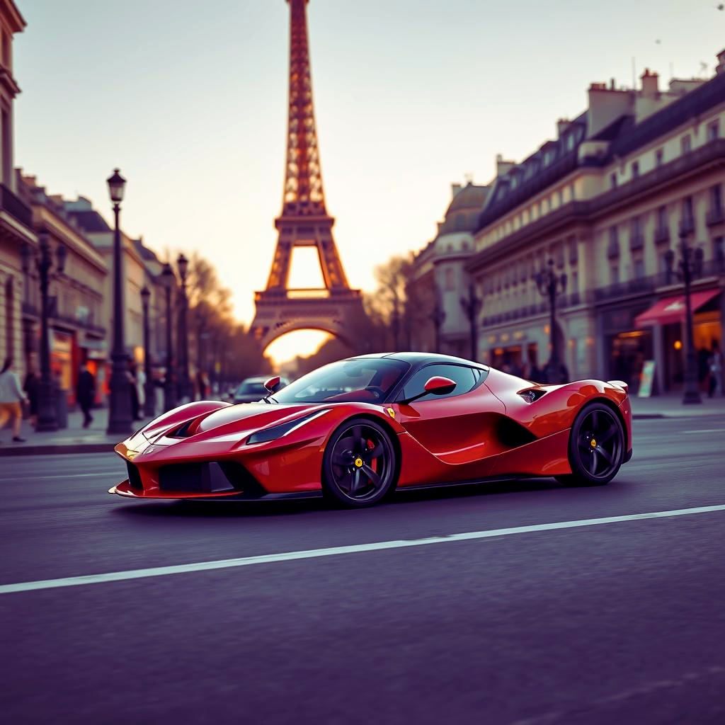
Financial Analysis

Slide 14
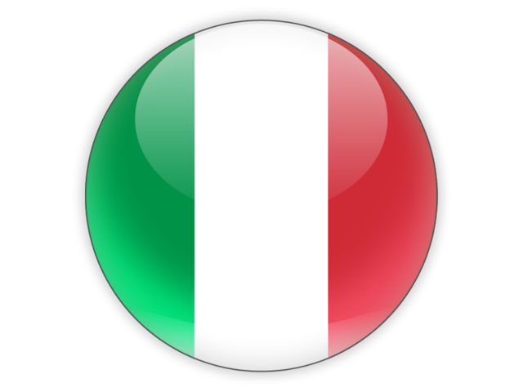
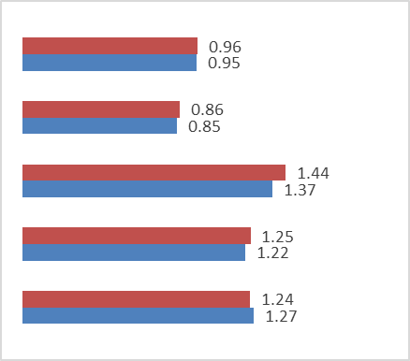
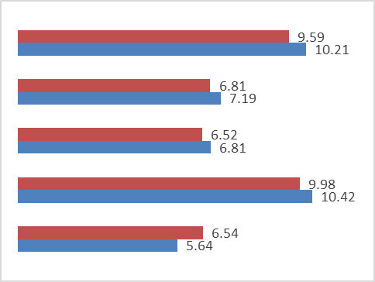
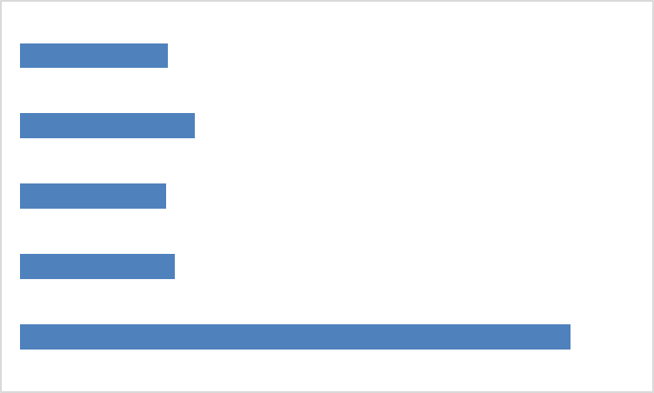
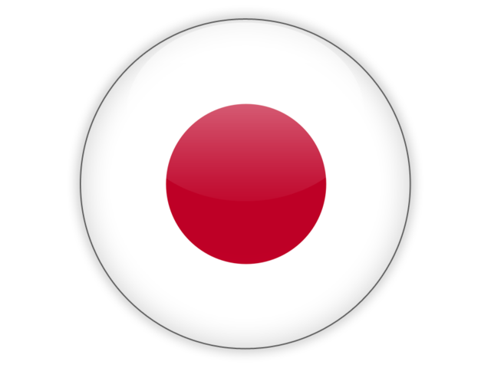
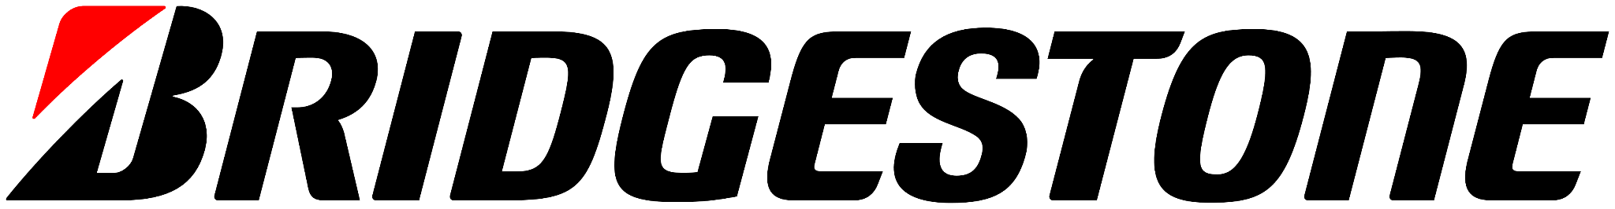
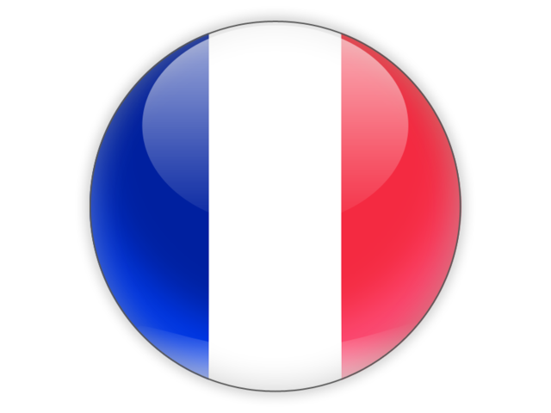
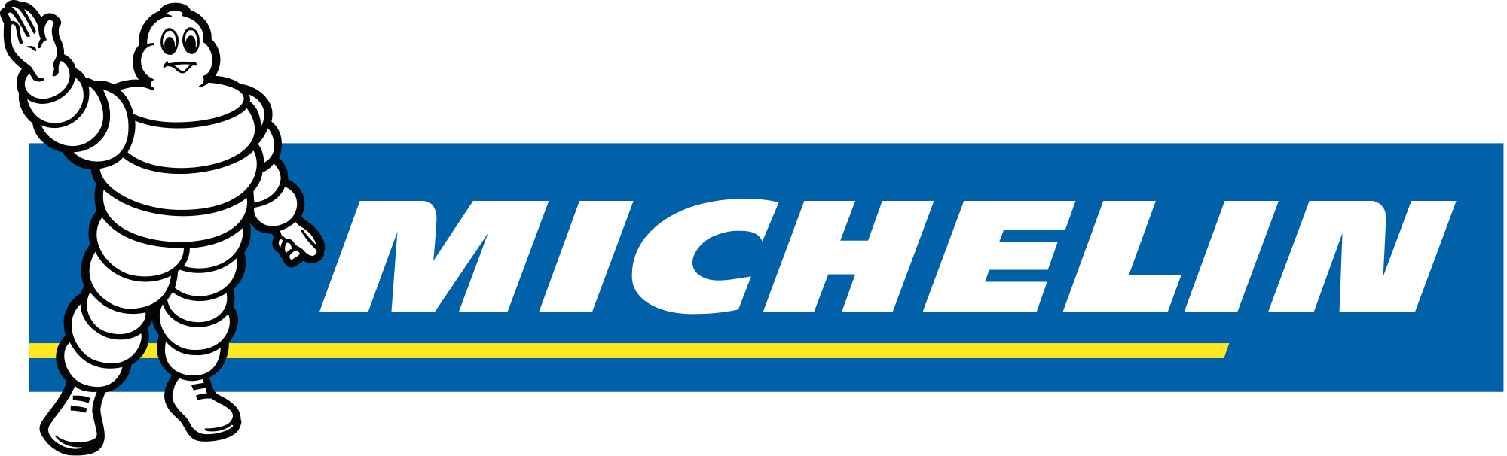
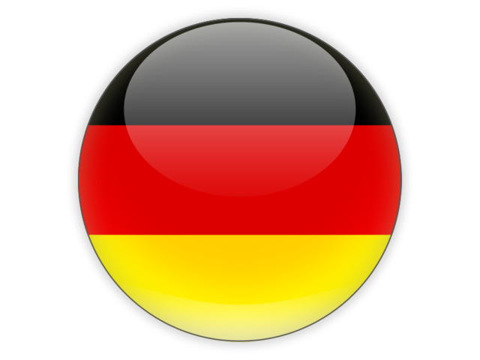



Peer Group Trading Multiples
Pirelli trades at comparable EV/Sales multiples but when incorporating profitability, it trades at a premium to its peers
LTM
Enterprise Value ($ m )
EV/Sales LTM-FY25E
EV/EBITDA
LTM-FY25E
P/E LTM
FY25E
9,001
12.03
35,619
14.26
39,083
11.87
35,262
12.58
44.88
17,941
Source: (Pirelli Preliminary Results, 2025), (Bridgestone 10-K, 2025), (Michelin Annual Results Guide, 2025), (Goodyear 10-K, 2025), (Yahoo Finance, 2025), (Continental Preliminary Results, 2025)
Executive Summary
Market Analysis
Strategic
Fit
Financial
Analysis
Feasibility
Alternative
Solution
Conclusion

Slide 15
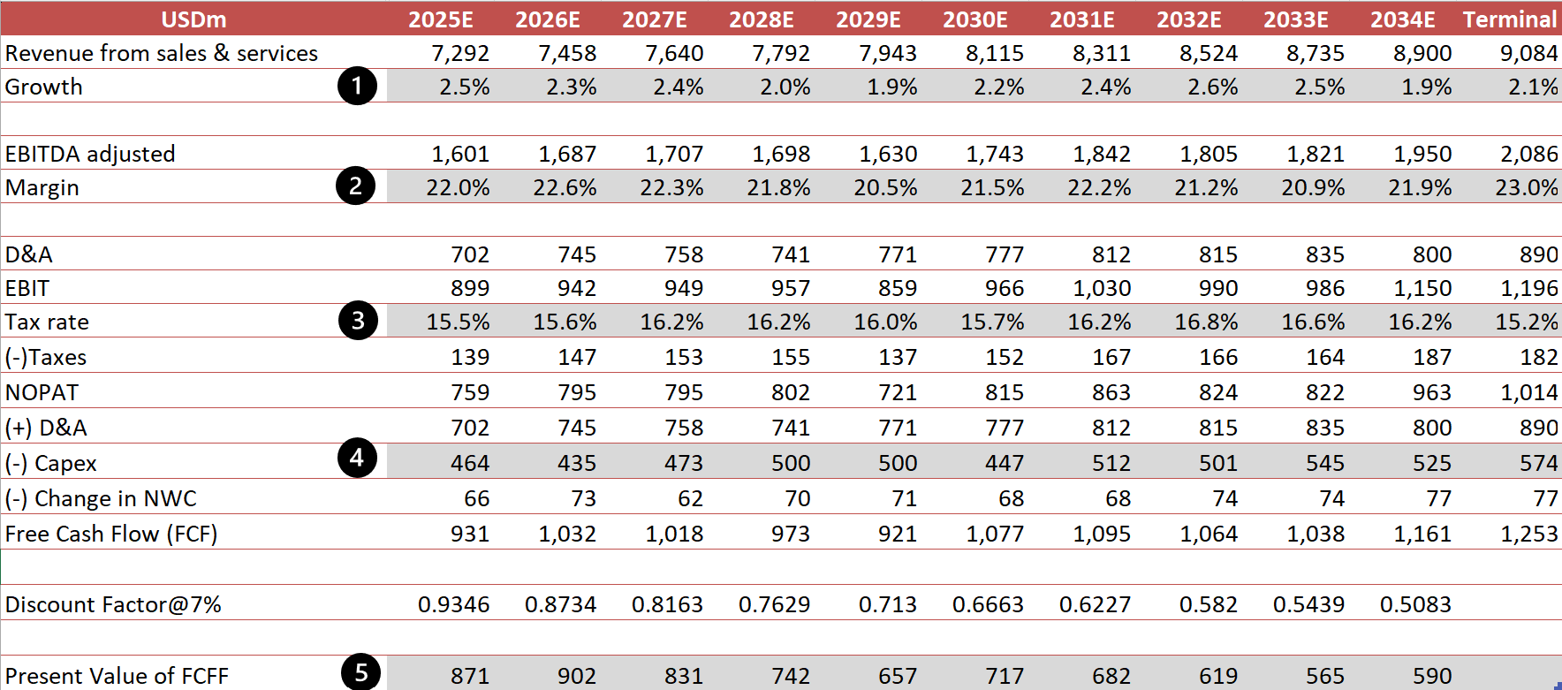





Pirelli Discounted Cash Flow (Base Case)
Pirelli is overvalued according to intrinsic value and trades at an all-time high
Commentary
Sales of ≥18-inch rim tires grew 7% (outpacing the market’s 5%), driving profitability and revenue expansion.
€289.5M invested in R&D iin 2024, with projects like sensor-integrated tires in partnership with Bosch and sustainable production initiatives.
Benefits from premium market positioning and automaker collaborations, aligning with EV growth and global tire demand stabilization.
Adj. EBITDA margin was 22.4% in 2024, with projections remaining in the 22–23% range for 2025.
High-value product focus, operational efficiencies, and strategic investments maintain strong profitability.
Free cash flow to the firm was used instead of AFFO.
Better reflects high level of capital expenditure to enable growth
Plans to invest €420M in 2025, maintaining a 6% CapEx-to-revenue ratio.
Focus on advanced manufacturing, high-value tire development, and automation to enhance production efficiency.
Increasing production capacity in the U.S. to mitigate potential import duties and strengthen market presence.
Significant interest expense deductions reduce taxable income below EBIT and lowering the effective tax burden.
Operates in low-tax jurisdictions (e.g., China, Romania), helping to keep the EBIT-based tax rate low
Historical EBIT-based tax rates have generally ranged between 15–18%.
Source: (Pirelli Preliminary Results, 2025), (Pirelli 10-K, 2024), (Pirelli 10-Q, 2025)
Executive Summary
Market Analysis
Strategic
Fit
Financial
Analysis
Feasibility
Alternative
Solution
Conclusion

Slide 16
Revenue Synergies
Synergies can be generated through brand highlight, cross-selling, and enhanced penetration
Insight
Reasoning
Brand
Premiumization
Exclusive tires enhance Ferrari’s luxury image
High-performance tires strengthens competitive advantage
The exclusivity increases perceived value as an ultra-premium automotive brand
Motorsport-proven technology reassures customers superior performance
Ferrari has high-net-worth buyers who own other luxury vehicles
Lead to aftermarket tire sales, recommending increasing sales
More likely to invest in premium Pirelli tires for other vehicles
A brand-backed endorsement increases consumer confidence & loyalty
Cross-Selling
Opportunities
Joint R&D tailored tires for upcoming electric supercars
Leverage Pirelli’s existing distribution network
Pirelli’s expertise helps create custom tire solutions
Pirelli’s established supply chain enables efficient market penetration
Enhanced Penetration
Source: (Ferrari 10-K, ), (Pirelli Preliminary Results, 2025), (Pirelli 10-Q, 2025), (Coolest Gadgets, 2025)
Executive Summary
Market Analysis
Strategic
Fit
Financial
Analysis
Feasibility
Alternative
Solution
Conclusion

Slide 17
Cost Synergies
Cost synergies can be generated through lower production costs, operational efficiencies, and innovation cost sharing
Insight
Reasoning
Lowered Production Costs
Ferrari benefits from direct control over tire manufacturing, cutting middleman costs.
Vertical Integration eliminates third-party supplier margins, making cost structures more efficient.
Operational Efficiencies
Streamlined logistics and combined supply chain efforts reduce shipping and handling expenses.
Centralized supply chain management results in economies of scale, lowering per-unit distribution costs.
Joint R&D initiatives in motorsport and electric vehicle tires will improve innovation while cutting costs.
Shared investments in technology eliminate redundant research spending while producing better solutions for both brands.
Innovation Cost Sharing
Source: (Ferrari 10-K, ), (Pirelli Preliminary Results, 2025), (Pirelli 10-Q, 2025), (McKinsey, 2022)
Executive Summary
Market Analysis
Strategic
Fit
Financial
Analysis
Feasibility
Alternative
Solution
Conclusion

Slide 18
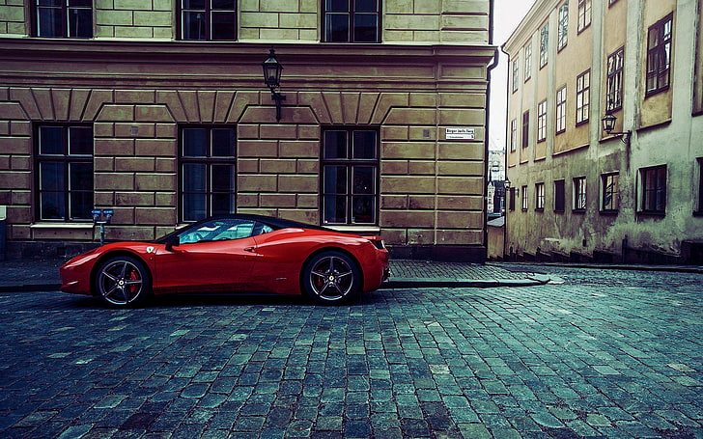
Feasibility

Slide 19




Ferrari Does Not Acquire Pirelli
Too Expensive
Structural, and Legal Incompatibilities
Maserati Acquisition(1997) Ferrari invested approximately US$350 million to acquire
PV(3.5% inflation) = 971M
Operational Misalignment: Ferrari's significantly higher net income rate suggests fundamental operational differences from Pirelli, making structural integration problematic.
Pirelli Acquisition(2015)
ChemChina acquires Pirelli for US$7.7 billion
PV(3.5% inflation) = 9,350M
Huge Gap
Strategic Brand Incompatibility: The noticeable profitability gap indicates potential brand dilution risks, as acquiring Pirelli could undermine Ferrari's premium market position.
Regulatory Barriers: Acquisition complicated by Italian government protections and Sinochem strategic 37% stake in Pirelli, adding regulatory hurdles.
Tax Complexity: Ferrari’s simple Dutch structure incompatible with Pirelli’s complex international manufacturing footprint (Brazil, China, Romania), triggering costly tax issues.
Ferrari's strategic approach has historically favored partnerships over acquisitions, focusing on collaborations that enhance its core competencies without diluting its brand identity. This strategy is evident through:​Strategic Partnerships
Lack of Synergies:
Maserati and Ferrari share a sports car DNA (technological/brand synergies), whereas Pirelli is an industrial supplier with no direct technological complementarity.
Source: (Scuderia Ferrari, 2024), (Ferrari Corporate, 2024), (Pirelli Financial Report, 2023), (Ferrari Annual Report, 2022), (Pirelli Annual Report, 2022), (Reuters, 2023), (Ferrari Press Release, 2024), (Politico, 2024), (Company Filings, 2024).
Executive Summary
Market Analysis
Strategic
Fit
Financial
Analysis
Feasibility
Alternative
Solution
Conclusion
Notes:
Ferrari | Company Overview & News

Slide 20





Financial Feasibility
debt financing is not favorable with increasing interest rates
Ferrari does not rely on acquisitions for growth
Debt financing impact on risk
Pirelli would be valued at least 3x the cash ferrari has on hand
BBB+
Acquiring Pirelli using only debt would increase default risk, decreasing their credit rating and increase interest rates
Ferrari does not do frequent acquisitions
Ferrari needs sufficient liquidity to support its operations
relies on internal cash flow and reinvestment to expand business
Ferrari debt 2024: 3.3B
BB
Combination of financial structure is not feasible enough
Market Capitalization of Pirelli | $ 6.5 B
Cash Financing | $ 360 M
Additional Financing Required | $ 6.24 B
Debt Financing | $ 3.04 B
Equity financing | $ 3.2 B
Assuming market capitalization remains constant, issuing equity will drop stock price to $429.18 per share, or a 4% decrease in stock price
Must keep capital structure constant to maintain credit rating.
Debt/Equity Ratio: 0.95
0.36B
Needs Cash ratio of at least 1
@ $446.70 per share, 16 M shares must be issued
Ferrari can’t acquire much through cash due to liabilities
Ferrari should not acquire Pirelli
Executive Summary
Market Analysis
Strategic
Fit
Financial
Analysis
Feasibility
Alternative
Solution
Conclusion
Notes:
Ferrari | Company Overview & News

Slide 21

Alternative Solution

Slide 22









Tactics to strengthen Ferrari’s current position
By implementing company acquisition, Ferrari, which has high brand loyalty and has large growth potential in revenue, is able to excel in both markets
Expand Hybrid and Electric Offerings
Company Acquisition
Leveraging Racing Pedigree
Ferrari in luxury automotive market:
Market’s increased demands vehicles that balance power, efficiency, and sustainability
Regulatory compliance on possible stricter emission standards and future bans on combustion
Broader Market Reach by expanding potential customer base
Enhanced control over tire development and optimize handling tires to factories
Exclusive tire solution only for Ferrari models, allows for further differentiating from other luxury brands
Create cost and supply chain advantage
Stronger brand integration
Broader business opportunities
Building trust in performance by demonstrating Ferrari’s commitment to top-tier performance
Reinforcing Brand Prestige, maintaining its status as a premier luxury automotive manufacturer
Ferrari’s performance in motorsport (ex: Formula 1):
Source: (Search filings 2016), (Business research insights.com, 2025), (Fortune Business Insights, 2020), (f1-analysis, 2024)
Executive Summary
Market Analysis
Strategic
Fit
Financial
Analysis
Feasibility
Alternative
Solution
Conclusion
Notes:
Ferrari | Company Overview & News

Slide 23











Potential Acquisition Targets
While Ferrari could acquire several companies, Apollo Tyres Limited represents the most promising target.
Companies | Company Overview | Revenue | Strategic fit | Feasibility | Brand Alignment
 | Mid-sized tire manufacturer; Market cap $3,200 million USD; Founded in South Korea in 1941; 7-year CAGR ~4.4%
 | A top 10 global tire maker but remained mid-sized; Market capitalization of $3,600 million USD; Founded in 1917 in Japan; 7-year CAGR ~6%
 | A multinational tyre manufacturing company; Market cap is of $2,710 million USD; Incorporated in 1972 in India; 7-year CAGR ~9.7%
 | A multinational tire and rubber product company; Market cap of $3,720 million USD; Founded in Japan in 1945 y-year CAGR ~3%
Source: (Fortune Business Insights, 2020), (Yahoo Finance, 2025)
Executive Summary
Market Analysis
Strategic
Fit
Financial
Analysis
Feasibility
Alternative
Solution
Conclusion
Notes:
Ferrari | Company Overview & News

Slide 24




Apollo Tyres Limited Company Overview
Apollo Tyres Limited Company is the missing piece for Ferrari’s supply chain efficiency and market expansion.
Apollo Tyres Limited Company Overview
Detailed product overview
Apollo Tyres Limited is a global tire manufacturer known for producing high-quality tires for passenger vehicles, commercial trucks, and off-road applications.
Two Sub-brands in Apollo Tyres :
Geography Exposure :
1. Vredestein
Founded in the Netherlands, acquired by Apollo Tyres in 2009
Offers ultra-high-performance tires for sports cats and luxury vehicles
Well established and recognized across Europe
2. Apollo
Represents the primary tire offering of Apollo Tyres
Delivers quality performance and durability at competitive prices
Known as a trusted, cost-effective option balancing performance with affordability
Source: (Yahoo Finance, 2025), (Apollo Tyres Annual Report, 2024)
Executive Summary
Market Analysis
Strategic
Fit
Financial
Analysis
Feasibility
Alternative
Solution
Conclusion
Notes:
Ferrari | Company Overview & News

Slide 25






Apollo Tyres Limited Company Financial Overview
The declining Net Debt/EBIT ratio, with rising earnings and EBIT and a relatively low P/E ratio, suggests that Apollo Tyres is currently
undervalued compared to its competitors, indicating a favorable outlook for the potential acquisition of Apollo Tyres
Positive and strong earning trend:
Net Debt/EBIT (Ratio)
P/E Ratio
EBIT
Return on Equity (%)
Source: (Yahoo Finance, 2025) , (Apollo Tyres Annual Report, 2024)
Executive Summary
Market Analysis
Strategic
Fit
Financial
Analysis
Feasibility
Alternative
Solution
Conclusion
Notes:
Ferrari | Company Overview & News

Slide 26


Ferrari and Apollo Tyres Limited Strategic Fit
Enhancing Performance, Innovation, and Market Reach
Meeting Strategic Goals for Ferrari
Apollo Tyres Integration
Ferrari’s Potential Goals
With the acquisition of Apollo Tyres, Ferrari can maintain dominance in high-performance vehicles and motorsport and successfully transit to eco-friendly technologies without compromising performance.
Product
Offering fit
Synergy
Potential
Vredestein Ultrac Vorti A high-performance tire developed in collaboration with Giugiaro Design, focusing on superior handling and speed capabilities, aligning with Ferrari's performance requirements.
Alnac 4G Designed for passenger cars, this tire emphasizes performance and safety, which could be adapted for Ferrari's sports car lineup.
Combining the two firms’ product strengths and niche expertise would allow Ferrari to increase presence in emerging markets and luxury SUV segments with Optimizing R&D and production cost
Synergy Potential: Performance Enhancement Apollo’s High-Performance Tyres: Advanced rubber compounds and tread designs for superior grip and handling. Lightweight construction for improved fuel efficiency and speed. Fit with Ferrari: Customized tyres for Ferrari’s road and track vehicles. Enhanced cornering, braking, and acceleration performance.
Vredestein Ultrac Vorti represents the crown jewel of the Apollo Tyres acquisition
Leveraging Apollo's design and manufacturing capabilities to enhance performance metrics
Source: (Apollo Tyres. 2023), (Ferrari Annual Report. 2022), (Ferrari Sustainability Report. 2022), (Apollo Tyres Sustainability Report. 2022)
Executive Summary
Market Analysis
Strategic
Fit
Financial
Analysis
Feasibility
Alternative
Solution
Conclusion
Notes:
Ferrari | Company Overview & News

Slide 27


DCF Valuation of Apollo Tyres
The estimated DCF value of ApolloTyre stock is 433.16INR. Compared to the current market price 389.45INR, the stock is undervalued by 10%
Free cash flow forecasts ($ m)
Forecasted Balance Sheet
Cash flow forecast assumptions (base case)
Interpretations
Revenue Growth: 7% annually (based on industry growth and Apollo Tyres' historical performance).
Operating Margin: 10% (stable, assuming no significant cost pressures).
CapEx: 5% of revenue (consistent with historical levels).
Working Capital: 10% of revenue (efficient management assumed).
Debt Repayment: $50 million annually (based on current debt schedule).
Free Cash Flow: Expected to grow at ~3% annually.
Strong Growth: Apollo Tyres is experiencing consistent revenue and EBITDA growth, reflecting strong demand and operational efficiency.
Improving Financial Health: The company is generating positive free cash flow and reducing its leverage ratio, which indicates a healthier balance sheet.
Debt Management: The decline in leverage suggests Apollo Tyres is effectively managing its debt, possibly through debt repayment or EBITDA growth.
Source: (Alpha Spread, 2025), (Market Screener 2025).
Executive Summary
Market Analysis
Strategic
Fit
Financial
Analysis
Feasibility
Alternative
Solution
Conclusion
Notes:
Ferrari | Company Overview & News

Slide 28



Valuation of Apollo Tyres Including Synergies
Revenue synergies, by Industry
(As % of Stand-Alone Revenue)
Additional free cash flow with cross-selling synergies
Values of Apollo Tyres Including Synergies compared with the original value
Including revenue and cost synergies, Apollo Tyres is worth 46.07% more to Ferrari than its current value.
Ferrari should acquire Apollo Tyres given the strong synergies of the transactions
Source:
Executive Summary
Market Analysis
Strategic
Fit
Financial
Analysis
Feasibility
Alternative
Solution
Conclusion
Notes:
Ferrari | Company Overview & News

Slide 29








Risk Consideration and Financing Structure
Potential Concern
Financing Structure
low to high | Evaluation of Risk | Threat Assessment | Proposed Solutions
Geographical Market Disparity | Ferrari’s revenue distribution: 44% in Europe, Middle East, and Africa; 28% in Americas; 11% in East Asia vs. Apollo Tyres’ revenue distribution: 69% in India 26% in Europe (primarily from brand Vredestein) |  | Ferrari can rebrand Apollo Tyres by prioritizing Vredestein and repositioning Vredestein as its exclusive performance tire supplier
Product Portfolio Misalignment | Despite having brand Vredestein, Apollo Tyres has the brand Apollo which primarily produces tires for passenger, commercial and off-road vehicles, with 80% revenue generated from truck, bus, and passenger vehicle tires
Brand Gap | Apollo Tyres has Apollo which has strong presence in price-sensitive markets and is volume-driven vs. Ferrari has a low-volume, high margin approach
Manageable Debt Impact for Ferrari: Debt-to-Equity ratio is 5962/85872
=6.9%
Positive Value Uplift for both Ferrari and Apollo Tyres!
Ferrari should acquire Apollo Tyres
Source: (Apollo Tyres Annual Report, 2024), (Ferrari Annual Report, 2024)
Executive Summary
Market Analysis
Strategic
Fit
Financial
Analysis
Feasibility
Alternative
Solution
Conclusion
Notes:
Ferrari | Company Overview & News

Slide 30
Post Acquisition Strategy
Driving Sustainable Growth & Brand Excellence
Post-merger integration strategies
Electrification & Hybrid Expansion
Post-merger integration must consider branding, operation, and market
Ferrari can expand their strategic success position in EV field
1.Brand Integration and Positioning
Maintain Brand Identity Launch co-branded marketing campaigns highlighting the partnership between Ferrari and Apollo Tyres | Develop exclusive tyre lines for Ferrari vehicles to reinforce the luxury and performance association Ultra-Exclusive Ferrari Experience Program | Enhance digital configurators with AR/VR experiences for remote customization. Commit to carbon-neutral production by 2035 through renewable energy and sustainable materials.
2.Operational Integration
Integrate supply chain to ensure seamless production and delivery of tyres for Ferrari vehicles. Implement Ferrari's quality standards across manufacturing processes | Establish joint R&D teams to innovate Invest in R&D to develop eco-friendly tyres using sustainable materials and processes | Develop tyres with embedded sensors to monitor performance, wear, and road conditions Collaborate on advanced materials and technologies
Ferrari can collaborate with Apollo Tyres to develop custom EV-focused ultra-high-performance tires.
Apollo’s sustainable tire technology aligns with Ferrari’s ESG goals (carbon-neutral by 2035).
Apollo’s experience in sustainable rubber sourcing supports Ferrari’s ESG initiatives.
3. Market expansion
Expand Ferrari's presence in emerging markets Supply tyres to other luxury or performance car manufacturers | Develop a strong aftermarket strategy Leverage F1 Success to Strengthen Road Car Innovations | Grow Ferrari Challenge & GT customer racing for deeper brand engagement. Capitalize on Purosangue success by adding high-performance variants
Apollo Tyres can provide Ferrari with advanced, sustainable, and high-performance EV tire technology that enhances efficiency, grip, and lightweight construction
Executive Summary
Market Analysis
Strategic
Fit
Financial
Analysis
Feasibility
Alternative
Solution
Conclusion
Notes:
Ferrari | Company Overview & News

Slide 31
Conclusion

Slide 32




Conclusion
Ferrari shouldn’t acquire Pirelli
Boost Ferrari Performance
Ferrari needs sport car tires and Pirelli doesn’t have the technological complementarity
Pirelli is too expensive
Structural and legal incompatibility
strengthen its current position in the motorsport and luxury automotive engineering industry
Has huge potential to enlarge net income despite large market cap
Apollo Tyres is the best alternative
Apollo Tyres is financially feasible to be acquired by Ferrari
Has the technological assistance to produce high-end sport tires
Strategically fit with Ferrari
Executive Summary
Market Analysis
Strategic
Fit
Financial
Analysis
Feasibility
Alternative
Solution
Conclusion
Notes:
Ferrari | Company Overview & News

Slide 33
Bibliography

Slide 34
Bibliography
Coolest Gadgets. (2025). Ferrari Statistics By Unit Sales, Recent Car Launches, Revenue, Shipments And Country. Available at: https://www.coolest-gadgets.com/ferrari-statistics/ [Accessed 1 March. 2025]
Continental. (2025). Continental Market Capitalization. Available at: https://companiesmarketcap.com/continental/marketcap/ [Accessed 6 Mar. 2025]
Continental. (2025). Preliminary Consolidated Financial Statements 2024. Available at: https://cdn.continental.com/fileadmin/__imported/sites/corporate/_international/english/hubpages/30_20investors/40_20events/results/fyr_2024/2024_fact_sheet_en.pdf?_gl=1*12hvxfp*_ga*MTM1ODg0MTk5Mi4xNzQxMjk2ODE0*_ga_CXY4Q1X5YZ*MTc0MTI5NjgxMy4xLjEuMTc0MTI5Njg4NS4wLjAuMA. [Accessed 6 Mar. 2025]
Continental. (2025). “Continental Increases Profit and Drives Forward Realignment in 2025”. Available at: https://www.continental.com/en/press/press-releases/fiscal-year-2024/ [Accessed 6 Mar. 2025]
Ferrari. (2025). Form 10-K 2024 Annual Report. Available at: https://www.sec.gov/ix?doc=/Archives/edgar/data/0001648416/000164841625000027/race-20241231.htm [Accessed 21 Feb. 2025]
McKinsey. (2022). The Future of Automotive Computing: Cloud and Edge. Available at: https://www.mckinsey.com/industries/semiconductors/our-insights/the-future-of-automotive-computing-cloud-and-edge [Accessed 2 March. 2025]
Pirelli. (2024). Form 10-K 2023 Annual Report. Available at: https://corporate.pirelli.com/corporate/en-ww/sustainability/reports [Accessed 21 Feb. 2025]
Pirelli. (2023). Form 10-K 2022 Annual Report. Available at: https://corporate.pirelli.com/corporate/en-ww/sustainability/reports [Accessed 21 Feb. 2025]
Pirelli. (2024). Form 10-Q 2024 Interim Financial Report. Available at: https://corporate.pirelli.com/corporate/en-ww/investors/financial-publications/financial-reports [Accessed 23 Feb. 2025]
Pirelli. (2025). FY2024 Preliminary Results. Available at: https://corp2-assets.pirelli.com/corporate/Pirelli_FY2024_Preliminary_Results_Presentation.pdf [Accessed 1 March. 2025]
Yahoo Finance. (2025). Pirelli Market Capitalization. Available at: https://finance.yahoo.com/quote/PIRC.MI/key-statistics/ [Accessed 1 March. 2025]
Yahoo Finance. (2025). Goodyear Market Capitalization. Available at:https://finance.yahoo.com/quote/GT/ [Accessed 1 March. 2025]
Bridgestone. (2025). Form 10-K 2024 Annual Report. Available at: https://www.bridgestone.com/ir/library/result/pdf/e_r6_4_4_results.pdf [Accessed 1 March. 2025]
Bridgestone. (2025). Bridgestone’s Market Capitalization. Available at: https://www.bridgestone.com/ir/stock-quote/ [Accessed 1 March. 2025]
Michelin. (2025). Michelin Market Capitalization. Available at: https://www.michelin.com/en/investors/stock-exchange/share-data [Accessed 1 March. 2025]
Michelin. (2025). 2024 Annual Results Guide. Available at: https://dgaddcosprod.blob.core.windows.net/cxf-corporate/attachments/mtnjrz5tj4fdf1ku50enzo8f-2024-annual-results-guide.pdf [Accessed 1 March. 2025]
Goodyear. (2025). Form 10-K 2024 Annual Report. Available at: https://corporate.goodyear.com/us/en/investors/reports-and-filings.html [Accessed 1 March. 2025]
Search filings (2016). U.S. Securities and Exchange Commission. Available at: https://www.sec.gov/search-filings [Accessed: 08 March 2017].
Business research insights.com. (2025). Motorsports Market Share Report 2033 Overview. [online] Available at: https://www.businessresearchinsights.com/market-reports/motorsports-market-108693# [Accessed 9 Mar. 2025].
Fortune Business Insights (2020). Luxury Car Market Size, Share, Trends | Report, Available at: https://www.fortunebusinessinsights.com/luxury-car-market-104453 [Assessed 29 Jan. 2025]
f1-analysis. “F1 2024 Mid-Season Graphs and Stats - F1 Analysis.” F1 Analysis, (2024). f1-analysis.com/2024/08/11/f1-2024-mid-season-graphs-and-stats/#ferrari. [Accessed 9 Mar. 2025]
Apollo Tyres. (2024). Form 10-K 2024 Annual Report. Available at: https://corporate.apollotyres.com/investors/financial-reporting/#?activeTab=Annual_Report [Assessed 28 Jan. 2025]
Ferrari. (n.d.). Company Overview & News. Available at: https://www.ferrari.com/en-EN [Accessed 9 March 2025].
Ferrari Corporate. (n.d.). Key Metrics. Available at: https://corporate.ferrari.com [Accessed 9 March 2025].
MacroTrends. (n.d.). Ferrari Gross Margin 2015-2024. Available at: https://www.macrotrends.net [Accessed 9 March 2025].
Ferrari. (2023). Record 2023 Results Strengthen the Foundation for Continuous Growth. Available at: https://www.ferrari.com/en-EN/news [Accessed 9 March 2025].
BIT:RACE. (n.d.). Ferrari Financial Ratios and Metrics. Available at: https://www.ferraribit.com [Accessed 9 March 2025].
Carscoops. (n.d.). Ferrari Reopens Purosangue SUV Orders as Profits Surge by 27% in Q1. Available at: https://www.carscoops.com [Accessed 9 March 2025].
Ferrari. (2024, February 1). Ferrari FY 2023 Results Press Release. Available at: https://cdn.ferrari.com/cms/network/media/pdf/2024_02_01%20-%20Ferrari%20FY%202023%20Results%20Press%20Release.pdf [Accessed 9 March 2025].
Executive Summary
Market Analysis
Strategic
Fit
Financial
Analysis
Feasibility
Alternative
Solution
Conclusion
Notes:
Ferrari | Company Overview & News

Slide 35
Bibliography
Carscoops. (n.d.). Ferrari Reopens Purosangue SUV Orders as Profits Surge by 27% in Q1. Available at: https://www.carscoops.com [Accessed 9 March 2025].
Ferrari. (2024, February 1). Ferrari FY 2023 Results Press Release. Available at: https://cdn.ferrari.com/cms/network/media/pdf/2024_02_01%20-%20Ferrari%20FY%202023%20Results%20Press%20Release.pdf [Accessed 9 March 2025].
Ferrari. (n.d.). Ferrari. Available at: https://www.ferrari.com [Accessed 9 March 2025].
Ferrari. (2022). Ferrari Set New Sales Record in 2022 by Delivering 13,221 Cars. Available at: https://www.ferrari.com/en-EN/news [Accessed 9 March 2025].
CarExpert. (n.d.). Ferrari's Profit per Vehicle Puts Every Other Brand in the Shade. Available at: https://www.carexpert.com [Accessed 9 March 2025].
Alpha Spread. (n.d.). Pirelli Free Cash Flow Statement. Available at: https://www.alphaspread.com/security/mil/pirc/financials/cash-flow-statement/free-cash-flow [Accessed 9 March 2025].
Ferrari. (n.d.). Pirelli | Ferrari Corse Clienti Partner. Available at: https://www.ferrari.com/en-EN/corse-clienti [Accessed 9 March 2025].
Pirelli. (n.d.). Pirelli Adds a Tire for Ferrari 288GTO to Its Classic Collection. Available at: https://www.pirelli.com [Accessed 9 March 2025].
Pirelli. (n.d.). A New P Zero for the Ferrari Enzo. Available at: https://www.pirelli.com [Accessed 9 March 2025].
Pirelli. (n.d.). Supercars Get Tailor-Made High Performance. Available at: https://www.pirelli.com [Accessed 9 March 2025].
Pirelli. (n.d.). Ferrari Tires: The Prestige Selection. Available at: https://www.pirelli.com [Accessed 9 March 2025].
Ferrari. (n.d.). Ferrari FXX K. Available at: https://www.ferrari.com/en-EN/corse-clienti [Accessed 9 March 2025].
R&D Today. (n.d.). Pirelli’s Approach to Technology Roadmapping. Available at: https://www.rndtoday.com [Accessed 9 March 2025].
Ferrari. (2022, June 16). Ferrari Press Release Capital Markets Day 2022-1. Available at: https://www.ferrari.com/en-EN/press-release [Accessed 9 March 2025].
MBA Skoo. (n.d.). Ferrari SWOT Analysis – Key Strengths & Weaknesses. Available at: https://www.mbaskoo.com [Accessed 9 March 2025].
Pirelli. (2023). 2023 Results and Industrial Plan Update 2024-2025. Available at: https://www.pirelli.com [Accessed 9 March 2025].
Ferrari. (n.d.). Scuderia Ferrari Official Partners. Available at: https://www.ferrari.com/en-EN/scuderia-ferrari [Accessed 9 March 2025].
Ferrari. (2024). Another Year of Strong Performance: All 2024 Targets Exceeded; Further Growth in 2025. Available at: https://www.ferrari.com/en-EN/news [Accessed 9 March 2025].
RACE. (n.d.). Ferrari Market Capitalization. Available at: https://www.race.com [Accessed 9 March 2025].
Yahoo Finance. (n.d.). Pirelli (PIRC.MI) – P/S Ratio. Available at: https://finance.yahoo.com/quote/PIRC.MI [Accessed 9 March 2025].
Ferrari N.V. (2022). Ferrari 2022 Annual Results: Record Results with Expanding Demand. Available at: https://www.ferrari.com/en-EN/investors [Accessed 9 March 2025].
Pirelli & C. S.p.A. (2022). Pirelli 2022 Financial Results. Available at: https://www.pirelli.com [Accessed 9 March 2025].
Reuters. (2023, June 5). Ferrari Does Not Need to Buy Other Supercar Makers, CEO Says. Available at: https://www.marketscreener.com [Accessed 9 March 2025].
Ferrari. (n.d.). Ferrari and Qualcomm Partnership. Available at: https://www.ferrari.com/en-EN/press-release [Accessed 9 March 2025].
Politico. (n.d.). Italy Puts Brakes on Pirelli’s Chinese Shareholder. Available at: https://www.politico.com [Accessed 9 March 2025].
U.S. Securities and Exchange Commission. (n.d.). Company Filings and Releases: Ferrari and Pirelli. Available at: https://www.sec.gov [Accessed 9 March 2025].
Apollo Tyres. (2023). Product Portfolio. Available at https://corporate.apollotyres.com/ [Accessed 4. Mar 2025]
Ferrari Annual Report. (2022). Strategic Goals and Financial Performance. Available at https://www.ferrari.com/en-US [Accessed 4. Mar 2025]
Ferrari Sustainability Report. (2022). Commitment to Carbon Neutrality. Available at https://www.ferrari.com/en-US [Accessed 4. Mar 2025]
Apollo Tyres Sustainability Report. (2022). Green Manufacturing and Eco-Friendly Initiatives. Available at https://corporate.apollotyres.com/ [Accessed 4. Mar 2025]
Alpha Spread. Apollo Tyres DCF Valuation. (2025). Available at https://www.alphaspread.com/security/nse/apollotyre/dcf-valuation/base-case [Accessed 5. Mar 2025]
Market Screener. Apollo Tyres Analyst forecast. (2025). Available at https://www.marketscreener.com/quote/stock/APOLLO-TYRES-LIMITED-6493106/finances/ [Accessed 5, Mar 2025]
Executive Summary
Market Analysis
Strategic
Fit
Financial
Analysis
Feasibility
Alternative
Solution
Conclusion
Notes:
Ferrari | Company Overview & News

